Slide 1
Compiler

Slide 2
Overview and History
Cause
  Software for early computers was written in assembly language
  The benefits of reusing software on different CPUs started to become significantly greater than the cost of writing a compiler
The first real compiler
  FORTRAN compilers of the late 1950s
  18 person-years to build

Slide 3
Overview and History
Compiler technology
  is more broadly applicable and has been employed in rather unexpected areas.
    Text-formatting languages,
    like nroff and troff; preprocessor packages like eqn, tbl, pic
    Silicon compiler for the creation of VLSI circuits
    Command languages of OS
    Query languages of Database systems

Slide 4
What Do Compilers Do
A compiler acts as a translator,
transforming human-oriented programming languages
into computer-oriented machine languages.
  Ignore machine-dependent details for programmer
Programming
Language
(Source)
Machine
Language
(Target)
Compiler

Slide 5
What Do Compilers Do
Compilers may generate three types of code:
  Pure Machine Code
  Augmented Machine Code
  Virtual Machine Code

Slide 6
The Structure of a Compiler
Any compiler must perform two major tasks
  Analysis of the source program
  Synthesis of a machine-language program
Compiler
Analysis
Synthesis

Slide 7






The Structure of a Compiler
Source
Program
Scanner
Tokens
Parser
Syntactic
Semantic
Routines
(Character Stream)
Structure
Intermediate
Representation
Symbol and
Attribute
Tables
Optimizer
(Used by all Phases of The Compiler)
Code
Generator
Target machine code

Slide 8


The Structure of a Compiler
Source
Program
Scanner
Tokens
Parser
Syntactic
Semantic
Routines
(Character Stream)
Structure
Intermediate
Representation
Scanner
  The scanner begins the analysis of the source program by reading the input, character by character, and grouping characters into individual words and symbols (tokens)
Symbol and
Attribute
Tables
Optimizer
(Used by all
Phases of
The Compiler)
Code
Generator
Target machine code

Slide 9

The Structure of a Compiler
Source
Program
Scanner
Tokens
Parser
Syntactic
Semantic
Routines
(Character Stream)
Structure
Intermediate
Representation
Parser
Given a formal syntax specification (typically as a context-free grammar [CFG] ), the parse reads tokens and groups them into units as specified by the productions of the CFG being used.
As syntactic structure is recognized, the parser either calls corresponding semantic routines directly or builds a syntax tree.
Symbol and
Attribute
Tables
Optimizer
(Used by all
Phases of
The Compiler)
Code
Generator
Target machine code

Slide 10


The Structure of a Compiler
Source
Program
Scanner
Tokens
Parser
Syntactic
Semantic
Routines
(Character Stream)
Structure
Intermediate
Representation
Semantic Routines
Perform two functions
  Check the static semantics of each construct
  Do the actual translation
The heart of a compiler
Symbol and
Attribute
Tables
Optimizer
(Used by all
Phases of
The Compiler)
Code
Generator
Target machine code

Slide 11


The Structure of a Compiler
Source
Program
Scanner
Tokens
Parser
Syntactic
Semantic
Routines
(Character Stream)
Structure
Intermediate
Representation
Optimizer
The IR code generated by the semantic routines is analyzed and transformed into functionally equivalent but improved IR code
This phase can be very complex and slow
Symbol and
Attribute
Tables
Optimizer
(Used by all
Phases of
The Compiler)
Code
Generator
Target machine code

Slide 12

The Structure of a Compiler
Source
Program
Scanner
Tokens
Parser
Syntactic
Semantic
Routines
(Character Stream)
Structure
Intermediate
Representation
Code Generator
Interpretive Code Generation
Generating Code from Tree/Dag
Grammar-Based Code Generator
Optimizer
Code
Generator
Target machine code

Slide 13


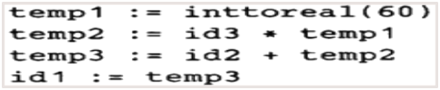



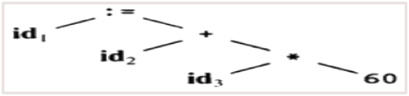



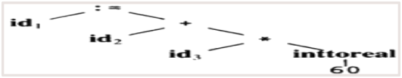
The Structure of a Compiler
Code Generator
[Intermediate Code Generator]
Non-optimized Intermediate Code
Scanner
[Lexical Analyzer]
Tokens
Code Optimizer
Parser
[Syntax Analyzer]
Optimized Intermediate Code
Parse tree
Code Optimizer
Semantic Process
[Semantic analyzer]
Target machine code
Abstract Syntax Tree w/ Attributes

